Slide 1
SATHYABAMA UNIVERSITY
UNIT- II
ENGLISH FOR SCIENCE AND TECHNOLOGY – SHS1101
UNIT II
Listening for inference, Describing a process, Cloze Reading and its types, Transcoding – Encoding & Decoding, Flow Chart, Bar chart, Pie Chart, Tabular Column, Tree Diagram, Technical Definitions Connectives & Discourse Markers, Word Association- connotations

Slide 2
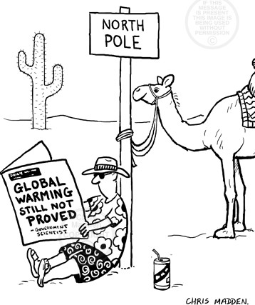
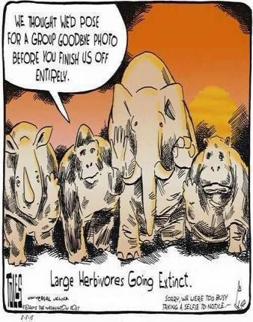
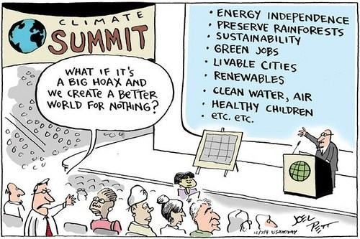
SATHYABAMA UNIVERSITY
UNIT- II
ENGLISH FOR SCIENCE AND TECHNOLOGY – SHS1101
Unit II - LIVE and LET LIVE
2.1.A. Listening for Inference: Vocabulary
Listing: Add to the list in the table below with any reasons for global warming that you know:
Reasons for Global Warming
Release of too much carbon dioxide (CO2)
Burning of fossil fuels like coal, oil and natural gas for energy
Cutting down and burning of forests to create pastures and plantations
Releasing other potent global warming gases, such as methane and nitrous oxide
Scan the cartoons to understand the meaning conveyed.
Discuss with your with your partner(s) the ideas mentioned below:
Which of the following ideas you think are conveyed through the cartoons?
People are in denial over Climate change.
People are refusing to believe the evidence about Global Warming.
People are falsely alarmed by unnecessary propaganda about Global Warming
Global warming is not about that is yet to happen, but it is already happening.
Is there any evidence provided in the cartoons in support of any of the above four assumptions?
What is the point of view of two sets of people that is suggested through the cartoons?

Slide 3
SATHYABAMA UNIVERSITY
UNIT- II
ENGLISH FOR SCIENCE AND TECHNOLOGY – SHS1101
2.1.B. While Listening:
Listen to the transcript read out in the classroom to infer the meaning conveyed through the dialogue. The transcript is an interview conducted by a journalist to two residents of Delhi. They talk about their preference for using private cars instead of using public modes of transport. Scan the table before proceeding with the task for better understanding.
Vocabulary: pet peeve-something that a person finds annoying
Listening Task:
No. | Where the interview could have been conducted in Delhi? Market, mall... etc | Employment of the interviewer | No. of people in the interview & names | Reasons for using car | Are you convinced by the reasons for private transport?
1.
2.
3.Listen to fill the gaps in the passage:
A pollutant is a substance or energy introduced into the environment that has undesired effects, or adversely affects the usefulness of a resource.
Many of India's big cities are experiencing such (1) that it almost defies belief. The standard measurement for healthy, normal, (2) is set at a level of 50 according to the Air Quality Index (AQI). A
level of 300 means the air is hazardous to breathe. The AQI website says 300 represents a health alert and the city should be put under ( 3)
. The website says that, "everyone may experience more serious ( 4)
". On November 8, the city of Chandrapur in Maharashtra reached an AQI level of 824, to become India's most polluted city. The capital New Delhi has reached an AQI of 724. ( 5) say many cities are now like "gas chambers".
2.1. C. Post Listening:
Mark true or false or not given for the following sentences based on your inference from the tasks in the lesson:
Climate change and global warming are two terms which describe the same thing.
A small number of scientists believe that climate change is a severe threat to the planet.
The greenhouse gases we produce form a blanket around the earth which makes it hard for heat to escape.
All greenhouse gases in the atmosphere come from industry, government and individuals.
Scientists are concerned about the physical and biological changes to the earth which are caused by climate change
If people use public transportation and stop driving cars to work and school, our country‟s carbon footprint would be much smaller.
Countries which produce the highest level of greenhouse gases are most likely to be affected by climate change.
If individuals and industries stopped producing greenhouse gases tomorrow, the world would soon return to its normal temperature.

Slide 4
SATHYABAMA UNIVERSITY
UNIT- II
ENGLISH FOR SCIENCE AND TECHNOLOGY – SHS1101
D. Follow up :
Discussion
What is the relationship between air pollution and global warming?
Is it a fact that Global warming happening? Or is it only a hoax? Do cloze tests A & B to get more ideas
Vocabulary:
A. Read the passage on „Global Warming the Greatest Scam in History' claims founder of Weather Channel‟ to chose the right options 1-4 to fill the blanks. If none of the options are correct write 5.
In an open letter attacking the Intergovernmental Panel –1--- Climate Change, he wrote: "The ocean is not ---2--- significantly. "The polar ice is increasing, not melting---3----. Polar Bears are increasing in number. "Heat waves ---4---actually diminished, not increased. There is not an --- 5 ---- in the number or strength of storms (in fact storms are diminishing). "I have ---6--- this topic seriously for years. It has become – 7--- political and environment agenda item, but the science –8--- not valid." Mr Coleman said he based many of – 9 -- on the findings of the NIPCC, a non- governmental international body of scientists aimed at offering an 'independent second opinion of the evidence reviewed by the IPCC.' He added: "There is no ----10----man-made global warming at this time, there has been none in the past and there is no reason to fear any in the future. "Efforts to prove the theory that carbon dioxide is a significant greenhouse gas and pollutant causing significant warming or weather effects have failed.
1. upon | 2. on | 3. into | 4. unto
1. rising | 2. rise | 3. rose | 4. risen
1. aware | 2. awareness | 3. away | 4. away
1. have | 2. has | 3. had | 4. have been
1. uptick | 2. unstuck | 3. stuck | 4. Tic
1. study | 2. studied | 3. studies | 4.sturdy
1. an | 2. the | 3. a | 4. that
1. is | 2. was | 3. were | 4. are
1. ideas | 2. opinion | 3. assumption | 4. views
1. evidence | 2. base | 3. significant | 4. Importance
B. Cloze test: Some words of the passage on “ Relation between Global Warming and Air Pollution‟ are removed to test your comprehension skills. Try filling the gaps with any words of your choice so as to make the sentences meaningful. The relationship is complicated. Global warming is usually 1 to carbon dioxide and other greenhouse gases. Carbon dioxide 2. not toxic to humans, and would only harm 3. if it managed to displace oxygen in the 4. . Common air pollutants are particulate matter or ash, hydrocarbons, ozone, and NOx among others.
The relation between the two is that 5. greenhouse gases and air pollutants tend to come 6 combustion. Reducing the amount of things combusted efficiently 7. sometimes more cleanly will result in reduced greenhouse 8. emissions and air pollutants. As air pollutants are released in western 9. , more sun is hitting the earth, and we 10. now experiencing the earth warming up.

Slide 5
SATHYABAMA UNIVERSITY
UNIT- II
ENGLISH FOR SCIENCE AND TECHNOLOGY – SHS1101
C. Follow up: Prepare K WL Chart on „Pollution in Indian Cities „ and „ climate change‟
Already Known | Want to Know | Ultimately Learnt
 |  | (complete after lesson 2)
Notes to the teacher: Read the transcript twice Listening transcript
Hi I'm Marcy a journalist. You're listening to a transcript read out by a teacher from
my podcast.
Well, you'd think that record high petrol prices would automatically lead to more and more people using public transport, you are mistaken. We interviewed two people on the issue and here is what they say the reasons for using their vehicles
Sanjay Arora: Hi, I‟m Sanjay Arora. Well, I live in the suburbs of Delhi. I work at
Sport Mart in the Unicity Mall. Every day I need to open my the shop at about 10:30 in the morning . However there were no buses coming from my area and dropping off at Unicity .
There is no convenient routes going there so I find it really difficult, kind of a, kind of a pain in my side actually, and ah yeah that that was my biggest pet peeve.
Dinesh Challa : Why do I drive a car? Well I work shift work so it‟s just not convenient for me to take a bus. If I were to take a bus it would probably take an hour, an hour and a half. Now to take a bus to work from Kodambakam to Sholinganallur at 10 everyday I need to start at 8.30 in the morning. To get home at 7 I‟d have to either hitch a ride with a buddy to Madhya Kailash or to ask some guys who live by Panagal Park, then I‟d have to wait for a bus there. That would probably take another hour. But if I take my car, I can avoid pollution, save time and reach
home early. I can get some sleep, get up early to spend some time with my kids, get them to school,. That would be too much time. However driving car is frustrating during rainy season then I go by my company bus. Then of course uhm I do enjoy taking the bus. It gives me time to relax and read, I can eat, and I can just, you know, think about stuff whereas with my car I have to be a little more lucid, a little more aware of what‟s going on.
Listening transcript
Many of India's big cities are experiencing such hazardous air pollution that it almost defies belief. The standard measurement for healthy, normal, breathable air is set at a level of 50 according to the Air Quality Index (AQI). A level of 300 means the air is hazardous to breathe. The AQI website says 300 represents a health alert and the city should be put under emergency conditions. The website says that, "everyone may experience more serious health effects". On November 8, the city of Chandrapur in Maharashtra reached an AQI level of 824, to become India's most polluted city. The capital New Delhi has reached an AQI of 724. Environmentalists say many cities are now like "gas chambers".
Suggested Answers for Cloze test B.
Attributed 2. Is 3. Someone 4. Air 5. Both 6. From 7. And 8. Gas 9. Countries 10. Are
2 . 2 : Framing Sentences: To Be or Not To Be
“Destruction is a man's will, Nevertheless Prevention is also a man's will,
It‟s a man's choice to choose between Destruction and Prevention.”
― Babu Rajan

Slide 6

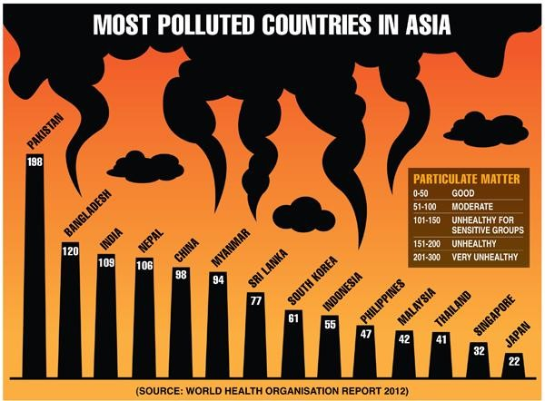
SATHYABAMA UNIVERSITY
UNIT- II
ENGLISH FOR SCIENCE AND TECHNOLOGY – SHS1101
Preparing to Write:
Read the poem to make a list of pollutants in the space given below.
Share your notes with partner(s)
If nature Suffers
Un-warranted and un-controlled civilisation, and exponential population explosion, Open drainage and ever-growing pollution, Human being creating all congestion.
Nature is bound to suffer, Nobody really bothers.
Man-made Factories & industries releases harmful gases,
Is human being really bothering? Leading to abnormal suicide.
Friends, get cautioned, awake and arise, Stop playing with nature guys,
If nature starts playing with us.
Unwarranted and untimely deaths will rise.
Source: www.poetryinnature.com
Pollutants in the poem Pollutants from my knowledge
---------------------- -----------------------------------------
--------------------- ------------------------------------------
Reading Between the lines:
Read the poem again to answer the following questions:
Why do you think population explosion leads to suffering of nature?
Why might the humans prefer „ abnormal suicide‟?
How can the nature play with us and how?
What choices as lay men we have between “ destruction and construction? Can we let our future to go up in smoke?
Choose the words in the box to fill the blanks
ordered clog dust haze factors except fair fire
A toxic (1) shrouds India's capital and residents are being warned to wear masks. Schools were (2) closed for three days. New Delhi generally has its (3) share of pollution problems due to the nine million vehicles that (4) its streets, most not conforming to emissions standards. The situation has been made worse recently due to a number of (5)
. These include chemical pollution blowing in from nearby states, farmers setting (6) to straw as autumn arrives, and a lack of wind. To alleviate the crisis, city officials have ordered roads to be doused with water to stop
(7) from rising. They have also banned diesel-powered electricity generators for 10 days, (8) at hospitals and cellphone towers.
New Vocabulary Particulate matter is the sum of all solid and liquid particles suspended in air many of which are hazardous. It originates from dust storms, grassland fires, burning of fossil fuels in vehicles, power plants, but also various
industrial plants generate significant amounts of particulates.

Slide 7
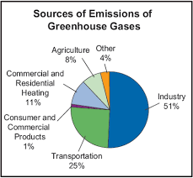
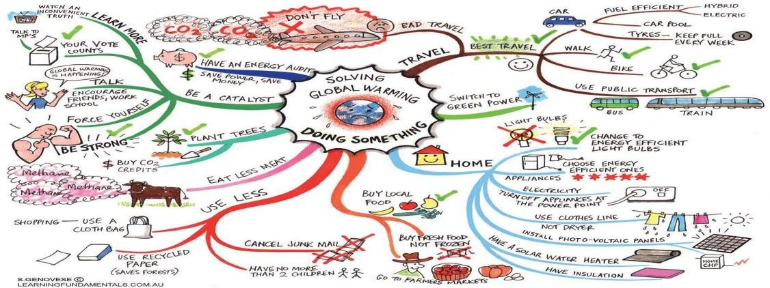
SATHYABAMA UNIVERSITY
UNIT- II
ENGLISH FOR SCIENCE AND TECHNOLOGY – SHS1101
5.Fact or Opinion?
Interpreting from the diagram: Scan the bar diagram on most polluted countries to do the following task:
A fact is something that is true or can be proven or can be verified.
An opinion is your feelings or how someone else feels about a topic.
Discuss with your partner to identify the sentences that follow as Fact / Opinion / other
Air pollution is a major environmental issue affecting people across the world
Air pollution is a major cause for illness among people.
Of all the air pollutants, fine particulate matter (PM) is one of the most
hazardous pollution for the human health.
The particulate matter causes about 9% of lung cancer deaths worldwide, 5% of cardiopulmonary deaths and about 1% of respiratory infection deaths.
The interactive map shows that South Asia is badly hit by pollution caused by particulate matter.
While Pakistan has the highest concentration of particulate matter, countries like Bangladesh, Nepal and India are placed by the WHO in a category called “unhealthy for the sensitive people”.
That means people in these countries suffering from respiratory and heart disease, as well as elderly and children should limit outdoor exertion.
Many people in Chennai have breathing problems, it may be due to high levels of pollution.
Air pollution in China is as bad, if not worse, than in India but according to the WHO, the particulate matter concentration in
China and in countries such as Myanmar, Sri Lanka, South Korea and Indonesia remains
moderate.
There is the least presence of particulate matter in Philippines, Malaysia, Thailand, Singapore and Japan.
The government can reduce the levels of pollution by consistent efforts.
Discussion : Observe the given pie chart to discuss with your partner(s) to write down three opinions and three factual statements below:
Scan the image on Solving Global Warming to write a short paragraph by making use of opinion and factual statements.

Slide 8
SATHYABAMA UNIVERSITY
UNIT- II
ENGLISH FOR SCIENCE AND TECHNOLOGY – SHS1101
2.3 . Compare and Contrast Language Practice
Observe the words in bold
Which country has the highest level of pollution?
Which country has the lowest?
Comparatives are used to compare two things:
Superlatives are used to compare one thing against a group of others: Here are the basics of how they are formed:
 | Example Word | Comparative | Superlative
Words with one syllable | high | higher | the highest
Words with three syllables or more | productive | more productive less productive | the most productive the least productive
Words ending in –y | wealthy | wealthier | the wealthiest
Short words ending with a consonant /vowel /consonant | Hot | hotter | the hottest
Irregular | Good | better | the best
Some other useful words and structures are presented for practice. Do the exercises to understand them
Transitions- Fill the blanks with however/ In contrast/ On the other hand
The Middle East produces high levels of oil; , India produces none.
America produces large amounts of natural gas. , Japan produces none.
Germany makes great use of solar power. , most Asian countries us this method of power generation very little.
Fill the blanks with (Subordinating) Conjunctions - whereas / while/ Although
The Arab nations produce high levels of oil, India produces none.
America produces high levels of oil, Japan produces none.
the Arab Nations produced 100 tons oil, Korea produced none.
Other Structures: Underline six comparatives in the following sentences to note them in the place provided:
Example: Developing countries are more reliant on alternative energy production than developed countries.
Solar power accounts for far less of the total energy production than gas or coal does.
Hydropower is not as efficient as wind power.
Like Japan, South Korea does not produce any natural gas.
The Middle East produces twice as much oil as Europe.
Western countries consume three times more oil than the Middle East.
Russia consumes slightly more oil than Germany.
The UAE produced the same amount of oil as Saudi Arabia.
Enter the expressions that were underlined in the above sentences here:
more … than

Slide 9
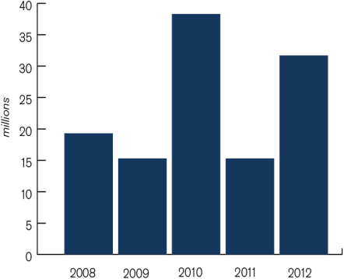
SATHYABAMA UNIVERSITY
UNIT- II
ENGLISH FOR SCIENCE AND TECHNOLOGY – SHS1101
When you compare and contrast, you also need to learn phrases so you can refer to data that is not exact. Notice the phrases in italics and usage of impersonal passive voice structures.
Just over twenty million people were displaced in the year 2008
Fill the blanks in the following factual statements by
using impersonal passive structures:
Approximately forty million people
Nearly sixteen million people
Almost thirty five million people
Figure: The Number of People Displaced Over the Years
Nearly the same number of people were displaced in the year
In the year 2010 the number people displaced was two times more than
The words given in the table can be used in compare contract paragraphs:
but, yet, however, although, even though, though, unlike, not like, not the same as, dissimilar, different from, in contrast (to), contrary to, compared to / with, in comparison, while, whereas, on the other hand
: Bar Diagram and Table
Vocabulary focus: Using contract and comparative words
Look at the bar diagrams on 1. „Most Polluted Countries‟ and 2. „The Number of People Displaced Over the Years‟ to fill the blanks with appropriate words:
Approximately thirty million people were displaced in the year 2012 the number people that were displaced in the year 2009 was only half of that.
Almost fifteen million people were displaced in the year 2011 the number people that were displayed in the year 2010 was two time more than that number.
The levels of pollution can be observed in Pakistan Japan has level of pollution.
The pollution in India is almost to the level of pollution In Nepal.
Next to Pakistan, Bangladesh has level of pollution which is the pollution level of India and Nepal.
While China shows moderate levels of pollution which comes to 98lbs, Srilanka, which is an island, surprisingly shows same levels of pollution.
Fill the blanks by choosing apt word given in the brackets for the passage given below:
Disasters related to weather events forced (1.about /around) 120 million people from their homes ( 2.during/ in the years) 2008-2012 alone. That‟s an average of 24 million people per year. (3.However/ Although) we cannot yet attribute this displacement to climate change, the Inter-governmental Panel on Climate Change (IPCC) has suggested that there is good reason to believe that the frequency and magnitude of these disasters may (4.in fact /actually) increase in the future due to human-induced climate change combined with socio-economic and demographic trends. (5.Besides/ Further to) this, the IPCC has highlighted how “for people affected by disasters, subsequent displacement and resettlement often constitute a second disaster in their lives.” (SREX report, 2012).(6. Much of / Most )of this displacement occurred in communities vulnerable to the destruction caused by floods and storms, (7.because of /due to) the poor quality of people‟s homes and their location in flood prone areas. The devastating damage and displacement of over four million people caused by Super Typhoon Haiyan in the Philippines is just one of ( 8.the latest /the most recent )examples.

Slide 10
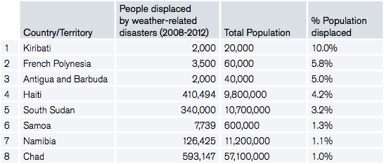
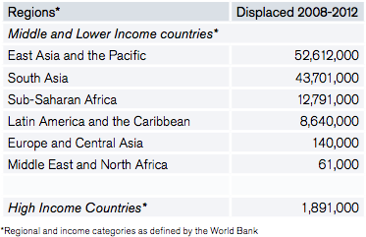
SATHYABAMA UNIVERSITY
UNIT- II
ENGLISH FOR SCIENCE AND TECHNOLOGY – SHS1101
3. Representing Information Given in a Table:
Study the following table to write a short paragraph of 150 words:
Table1: Countries with the highest relative levels of new displacement by weather- related disasters worldwide (2008-2012)
Table 2 : People displaced by climate and weather-related hazards during 2008-2012 Source: Michelle Yonetani, IDMC Senior Advisor on disaster-induced displacement
5.Critical Thinking: Peer Evaluation and reflecting:
Language item | A | B | C
Creativity & idea generation Use of factual and opinion statements. | Both factual and opinion statements used. | More use of one type statements and less use of the other type | Only factual statements used
Coherence & Cohesion Use of comparative and contras words / Phrases to connect the ideas. | At least three words and one phrase to connect ideas | Only contrasts or comparatives used | No use of comparatives / contrasts. Or Unnecessary usage or too much usage of comparatives and contrasting words
Mechanics of writing: Heading, use title and topic line, sentence structures in impersonal passive voice and correct tense | The paragraph has a title and topic line, all required sentences have structures in impersonal passive voice and the tense is correct with less than two spelling and punctuation errors | The paragraph has a title and topic line, some sentences have structures in impersonal passive voice and the tense is wrong in some places with less than two spelling and punctuation errors | The paragraph has no a title and topic line, sentences have no impersonal passive voice and the tense is wrong in more than five places. More than five spelling and punctuation errors
A 4 marks , B= 3 marks, C =2 marks; Calculation: Total marks: if all As ( 3x4=12) References : http://www.ieltsbuddy.com/compare-and-contrast.html

Slide 11
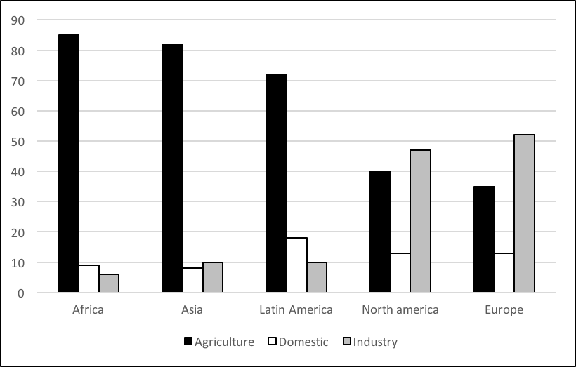
SATHYABAMA UNIVERSITY
UNIT- II
ENGLISH FOR SCIENCE AND TECHNOLOGY – SHS1101
4. Follow up: Write a compare contrast paragraph based on your observation of the data presented in the bar diagram on „ Usage of Water‟. Start with the topic line provided: The bar chart represents the water use given in percentage in a number of different regions in 1995.
A.Prepositions of time: Correct use of prepositions is important while representing information: Here are some of the main prepositions you will need to use:
in [month / year / morning, afternoon etc]
at [9 o‟clock, 10.30 am etc]
from..[a point in time]..to… [another point]
between…[a point in time]..and… [another point]
during [a period of time]
before [a point in time or a period of time] after [a point in time or a period of time] by [a point of time arrived at]
until [a point of time reached]
since [from a point in the past until now]
Prepositions to describe increase and decrease
Verbs that take a preposition | Verbs that don’t take a preposition | Nouns that take a preposition
rise to/by increase to/by fall to/by drop to/by shoot up to/by plunge to/by stay at remain at fluctuate between/around | reach | a rise of an increase of a fall of a decrease of
1.Scan the chart to complete the report below with a suitable preposition wherever needed:
The chart shows fluctuations in the price of crude oil over a thirty five year period, and clearly illustrates how oil prices are affected by world events. In general there has been an upward trend in the price of crude oil [1]…….. 1970, when it was only $1.30 per barrel. The oil embargo of the early 1970s, however, caused the price to rise sharply [2]…….. nearly $11
per barrel. The crisis ended soon afterwards, but the price remained [3]…….. around $11 to

Slide 12
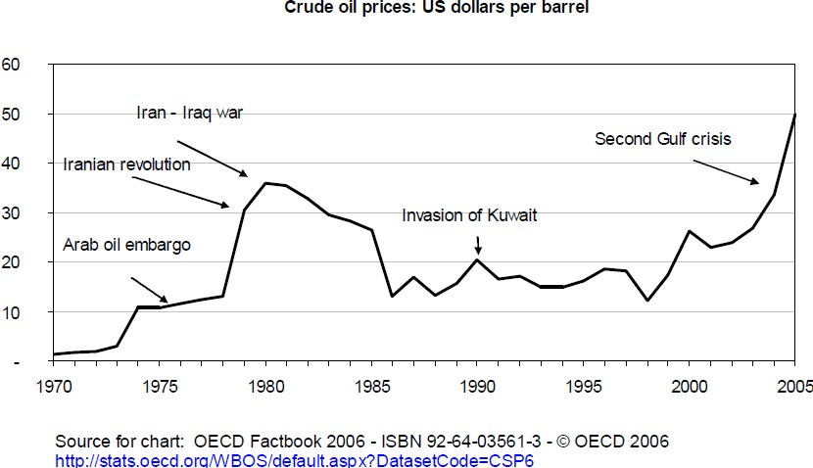
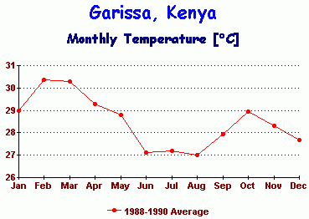
SATHYABAMA UNIVERSITY
UNIT- II
ENGLISH FOR SCIENCE AND TECHNOLOGY – SHS1101
$13 per barrel until 1979. The Iranian revolution of that year had a huge impact on oil prices, which shot up [4]…….. $17 to reach [5]…….. about
$30 per barrel in the same year. The following Iran Iraq war caused a further increase, and the price reached [6]…….. a peak [7]…….. nearly $36 in 1980. From that point until 1985, the price fell steadily. However, from 1985 to 1986 the price suddenly plunged [8]…….. $13. For the next few years the price fluctuated [9]…….. $14, but with the invasion of
Kuwait in 1990 there was a sudden rise [10]…….. $5. The price quickly fell again and remained stable for most of the 1990s. Things changed once again at the end of the decade, and from 1999 to 2000 the price increased [11]…….. almost $10 per barrel. Despite a slight drop in 2000, the rise continued and by the end of the period, the price of crude oil had shot up [12]…….. a peak of $50 per barrel.
2.Read the adapted passage from a science article “Out of Africa” to fill the blanks with suitable conjunctions given in the brackets:
The IPCC claims that `climate sensitivity' is about 1°C per `watt per square metre' (wm-2). –1--- (As/ Since) a doubling of CO2 is claimed to increase atmospheric energy by 3.8 wm-2, it follows that the global warming the models would predict would be 3.8°C, right in the mid-range of the IPCC's predictions.
2_ ( In order to/ because of) falsify claims of IPCC, the study records 3 ( as well as / and ) presents of monthly temperature from Garissa in Kenya. Garissa is a small town sitting almost on the equator 4 (and / besides )is also closer to the Indian Ocean. 5 ( Due to this / because of this ) the ocean cannot
dampen temperature variations there. 6 ( On the other hand, moreover) it does not have the normal seasons associated with places further north or south as the sun is directly overhead twice a year . 7 (Since/ So) Garissa is on the equator, with a climate uncomplicated by normal seasons, it should be especially responsive to this 7% annual variation in solar radiation. 8 (Though /But) the temperature does not vary by 25°C 9 (hence/ as) would be suggested by a climate sensitivity of 1°C per wm-2. _10 (But / Instead) it varies only 3°C
between a February peak and an August minimum. 11 (And / Thus), the
climate sensitivity at Garissa
= 0.12°C per
is only 3/25
wm-2,
12 ( Unless/ If)
this applied
sensitivity is
globally,
`global warming' would amount to a mere 0.12
3.8°C as claimed by the IPCC.
x 3.8 = 0.46°C, not
It means that global warming, 13 (if/
unless) it happens at all, will only be measurable in tenths of a degree, not whole degrees. 0.45°C is hardly the stuff of catastrophe.

Slide 13
SATHYABAMA UNIVERSITY
UNIT- II
ENGLISH FOR SCIENCE AND TECHNOLOGY – SHS1101
3. Write a short paragraph based on your understanding of the graph provided on Monthly temperature of Garissa, Kenya. Follow the instructions provided for writing comparison and contrast paragraphs.
Discourse Markers:
Adverbs are used as sentence connectors along with conjunctions. They are referred to as discourse markers-adverbs of time references
Discourse markers are not part of the sentences.
They are used at the beginning of utterances.
They do not have meanings of their own to function independently.
Markers for various contents
Addition: moreover, also, what is more, too, either, neither, nor
Enumerations: (listing/naming one by one) at first, secondly, furthermore, next, then, last, first and foremost, more importantly, to start with, and to with, and to conclude.
Contrast:
Instead, on the other hand, on the one hand. Concession:
Besides, else, however, still, yet, nevertheless
Transition:
And, now, by the by, in the meantime
Attitude / viewpoint Indeed, in fact, actually
Result:
Hence, so, therefore, as a result
Inference:
Else, otherwise, in other words, then
For example, for instance, that is, that is to say, namely.
4.
A. Discourse markers- Exercises
Read to poem written by Walt Whitman to discuss the questions with your partner(s):
Who are the two persons in the poem?
Who answered the question?
From where does the speaker originate?
What happens when the speaker goes up to the sky?
What does the speaker do to the place it originates from?
What is the tale of the speaker in the poem?
Explain the process in the formation of rain by drawing a flow chart
THE VOICE OF THE RAIN - Walt Whitman
And who art thou? said I to the soft-falling shower,
Which, strange to tell, gave me an answer, as here translated: I am the Poem of Earth, said the voice of the rain,
Eternal I rise impalpable out of the land and the bottomless sea, Upward to heaven, whence, vaguely form'd, altogether changed, and yet the same,
I descend to lave the drouths, atomies, dust-layers of the globe, And all that in them without me were seeds only, latent, unborn;
And forever, by day and night, I give back life to my own origin, and make pure and beautify it;
(For song, issuing from its birth-place, after fulfilment, wander-ing, Reck'd or unreck'd. duly with love returns.)

Slide 14
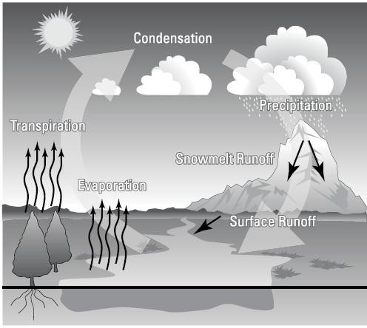
SATHYABAMA UNIVERSITY
UNIT- II
ENGLISH FOR SCIENCE AND TECHNOLOGY – SHS1101
How does a rain originate according to the rain drops that reply in the poem? What does science tell about the process of rain fall?
2.Work in pairs to add discourse markers to one of the passages given below:
A Rainy Day gives me sweet memories. Rains are blessings. Rains are a curse. Hope we could control rains. If we can bring them on wherever we are in need or keep them off as long as we desires them, rains can be a blessing. It was a day when it rained and I did not like it. It was a holiday. I had planned to enjoy the day. I was to pay a visit to my sister at Thriuttani. It is at a distance of 75 kilometers from my place.
I started from house early morning. I could see bad weather ahead. Dark, smoky clouds threatened rain. I thought I would be safe if I got into a bus. I
was getting into the bus when it started raining. It rained the way it has never rained. In a very short time the roads were flooded. The traffic came to a standstill. It poured so heavily that even there headlights of the bus could not pierce the thick sheet of water pouring form the sky. Those inside the shops and buses were in no way better than those outside on the road who were getting wet in utter helplessness. A man running to catch a bench fell into a drain. The poor man stood for a moment looking dazed at the rushing water.
It rained for four hours during which period all activities came to a standstill.
When at last the rain stopped, I was hardly in shape to carry on my journey. I felt home sick and longed to be at home in my comfortable bed. Hence I came home.
B. Conjunctions and Connectives
Conjunctions or linking words are used to connect clauses or sentences.
Conjunctions of time - as, when, while are used to refer to an action taking place at the same time as another.
When my mother wakes me at 5'o clock, I get up.
As I was looking out of the window, I saw him coming.
While you were sleeping, you friend called.
After, as soon as, before, when are used to refer to one action taking place immediately after another.
After I left my school, I went to work in Chennai.
As soon as I saw him on T.V. I changed the channel.
He left the room before I could ask his permission.
When I heard him calling you, I informed you.

Slide 15
SATHYABAMA UNIVERSITY
UNIT- II
ENGLISH FOR SCIENCE AND TECHNOLOGY – SHS1101
Until / till is used to refer to the length of time a situation continues.
I can't go out until I receive a call from my mother.
I can't give you the book till I finished reading it.
Although, even though, though are used to refer to opposing or contrasting statements before a subject and a verb.
Although he is a student, he has never received a merit certificate.
Even though there is a time limit, he always takes extra time.
Though he studied hard, he didn't manage to pass the exam.
In spite or despite are used to refer to opposing or contrasting statements before a noun, pronoun or gerund.
In spite of the traffic, I managed to go there on time.
Despite of his anger, he listened to me patiently.
While, whereas are used to refer to a contrast between two statements.
I work hard but my brother hardly works.
I went there on time whereas my friends were late.
However is used to a contradiction between two statements.
The agent was asked to meet the contractor at 8'o clock. However, when he arrived, the contractor wasn't there.
Conjunctions of Cause and Effect
Because, because of, as, since are used to refer to reasons for doing something.
The machine stopped because of the technical fault.
The machine was rejected because it was not the one they have ordered for.
As the machine was not working, we had to close the shop early.
Since our fax machine is not working, we rented the fax from an outsider.
So, therefore are used to refer to the result of something.
Suja's calculator is not working so she bought another
Suja has to attend the workshop at Salem tomorrow.
Therefore she is leaving this evening.
d. Conjunctions of Purpose
to, in order to, so as to, for, so that, in order that are used to convey the purpose of action
He stopped the engine so as to oil it properly.
I joined the course in order to improve my skills.
He stood up to greet the teacher.
Exercises :
Fill in the blanks with indications of purpose
Thermometer is used measure the temperature.
Pendulum clock is used measuring time.
People watch T.V. they may relax after tedious work.
Students concentrate more on practical classes they may gain practical knowledge.
Graphics are used collecting data.
5. Rewrite the following statements by using indicators of purpose.
Cooling becomes essential in IC Engines. Air cooling or water cooling is used.
Lubricant is used. It reduces the temperature of the working parts.
A good network of transport system is maintained. It enables economic, industrial and cultural growth of a country.
Many suggestions have been made. They reform the election process.
Steam turbines are used. They run generators in thermal power plants.

Slide 16
SATHYABAMA UNIVERSITY
UNIT- II
ENGLISH FOR SCIENCE AND TECHNOLOGY – SHS1101
Conjunctions- Exercises: Join the sentences using conjunctions or connectives.
There are many sites which have mechanical attitude. They are bothered only about the mechanical information.
It is one thing to keep ourselves updated with medical information. It should not be strictly followed on doctor's prescription.
Doctors agree Internet has potential use. They are also worried about possible damages.
The thought of hospital frighten many of us. Doctors sometimes do wrong diagnosis.
Medical advice should be unbiased. They should be no profit motivation behind it.
Mini computers are very cheap. They are smaller and slower than the main frames.
Glass breaks easily. Glass has so many properties.
Calculators are now very much used. They make calculations easy.
There were frequent interruptions during his speech. He continued to speak.
2.7 . Line graph and Bar Diagram
The following are some useful expressions for describing increase and decrease in line graph and bar diagram:
rapid | slow
sharp | slight
steep | gradual
dramatic | Barely noticeable
marked
A rise | A fall
An increase | A decrease
To increase | A reduction
To shoot up | To decline to shoot up
Read the following paragraph and draw a pie chart based on the information provided.
The pie-chart gives information on the world population figures in 2001. Overall, almost three-quarters of the world‟s population live in Asia and Africa. Asia is by far
the biggest region, with 3721 million people. The second largest area is Africa, with 813 million, less than a quarter of Asia‟s population. Europe has three quarters of a billion people. Together, Latin America and North America have about 840 million. Finally, Australia and New Zealand have less than 31 million. As can be seen, the greatest concentration of the world‟s population is in Asia, with Africa far behind.
2.8 Tables and Charts: Useful expressions
The following are some useful expressions for describing Tables/ chart
According to the statistics/ table/ graph/ figures presented… It can be seen from the statistics that…As is shown / as can be seen … in the table
1. There are a number of different ways of expressing the same figure in English. For example, we can say „a half‟, „one in two‟ or „fifty per cent‟ and they all mean the

Slide 17
SATHYABAMA UNIVERSITY
UNIT- II
ENGLISH FOR SCIENCE AND TECHNOLOGY – SHS1101
same. It‟s a good idea to vary the way you express figures in your description of the table or chart. All the phrases below can be used to describe figures.
Group the phrases which in the box that have similar meaning:
a fifth a quarter a tenth a third just over sixty per cent just over thirty per cent one in five one in four one in ten one in three seventy five per cent ten per cent three out of four three quarters twenty five per cent twenty per cent two out of three two thirds
2.Table: Complete the description by choosing the best word or phrase ( quantifiers) for each gap.
The table shows how 1 [much/many] time people spend on certain daily activities. Not surprisingly, everybody surveyed spent 2 [a lot of/many] time sleeping. However, men spent slightly 3 [fewer/less] time sleeping than women did. After sleeping, the next most time consuming activity was housework, taking up 178 minutes per day, on average. Again, though, there was a marked difference between
men and women, with women spending 4 [many/much] more minutes per day on this activity than men. In addition, a greater 5 [amount/number] of women than men reported that they spent time on housework and childcare. In contrast, men spent a greater 6 [amount/number] of time on their hobbies and games than women did. Very 7 [few/many] people surveyed spent much free time on entertainment and culture. For the 8 [majority/most] of people, free time was spent watching television. Almost nine out of ten people reported that they spent 9 [several/lots] hours watching TV every day.
2.9.Descriptive Writing : Flow chart and Tree Diagram:
Connectives and Useful Expressions
a. The following are some of the links we can use to show the sequence in which things happen:
e.g. flow chart description:
Use present tense in process description: Examples are given the in the box below:
The following are some useful expressions when describing processes:
At First First of all
To begin with
Beforehand Previously Earlier
At the same time Simultaneously
Secondly Next
Then Subsequently Later
Eventually finally
In the last stage
The first step is The first stage is
Begins with / Commences with
Before that/this Prior to that/ this
During
After this
The next step is In the next stage
In the following stage
Finishes with Concludes with The last step is
step- one action in a series of actions.
stage – a point or period of time in a series of actions.
process- a series of steps ; a way in which something happens or is done
Procedure- the order of doing things.

Slide 18
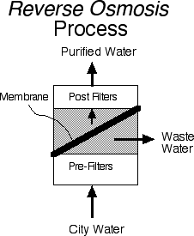
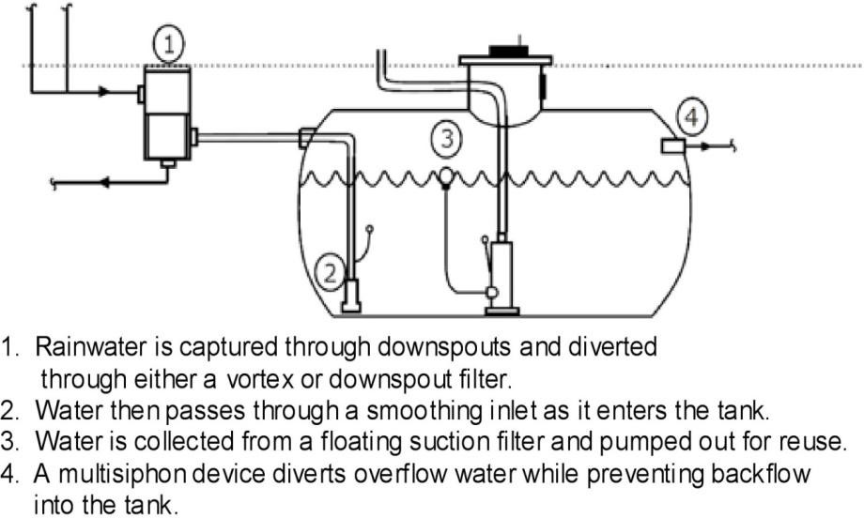
SATHYABAMA UNIVERSITY
UNIT- II
ENGLISH FOR SCIENCE AND TECHNOLOGY – SHS1101
Study the following passage to draw a flow – Chart:
The earth contains a large number of metals which are useful to man. One of the most important of these of Iron. The iron ore which we find in the earth is not pure. It contains some impurities which we must remove by smelting. The process of smelting consists of heating the ore in a blast furnace with coke and limestone and reducing it to metal. Blasts of hot air enter the furnace from the bottom and provide the oxygen which is necessary for the reduction of the ore. The ore becomes molten, and its oxides combine with carbon from a liquid slag. This floats on top of the molten iron, and passes out of the furnace through a tap. The metal which remains is pig iron.
We can melt this down again in another furnace - a cupola - with more coke and limestone, and tap it out into a ladle or directly into moulds. This is cast iron.
Look at the diagram to discuss the process of RO Process
Write a short paragraph explaining the types of rain water harvesting mechanisms based on the charts provided in the unit.
Group Work:
Fact: Do you know ? For every inch of rain on 1000 sq. feet of catchment area, you can potentially capture 600 gallons of rainwater. If a given season produces 10 inches of rain, that's 6000 gallons! How does it work?
Basically, it's a four-step process.
Scan the diagram to explain the four steps
5.Pair work: Speaking & Listening:
2.9. Listening & Speaking: Information Transformation
One student describes the picture to her/ his partner to draw a diagram ( Types of Rain Water Harvesting or Animal Kingdom). DO NOT show the picture.
The other student listens to the description to draw the diagram. Compare with a final chart to be displayed in the class after group comparison

Slide 19
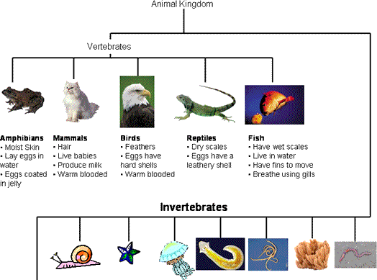
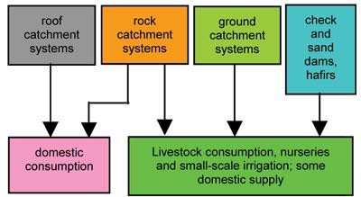
SATHYABAMA UNIVERSITY
UNIT- II
ENGLISH FOR SCIENCE AND TECHNOLOGY – SHS1101
2.10.Connotations &Denotations
Denotation is the literal meaning of a word, the dictionary definition.
The word mom means a female parent. The word mother also means a female parent. These two words share the same definition (and therefore the same denotation), but as we‟ll soon see, they can have very different connotations.
Connotation could also be thought of as the flavor of a word. Mom and mother both
have the same dictionary definition, but these words have different flavors once we put them into context. Consider the following sentences:
Mom, may I go out for shopping? Mother, may I go out for shooping?
The word Mom has an intimate and casual connotation whereas Mother carries a
more formal overtone
Identify detonations in the groups of words presented below:.
Childlike, Youthful, Childish, Young
Disabled, Crippled, Handicapped, Retarded
Relaxed, Laid-back, Lackadaisical, Easy-going
Slim, Skinny, Slender, Thin
Cheap, Frugal, Miserly, Economical
Young, Immature, Juvenile, Youthful
Inquisitive, Interested, Curious, Convivial
Confident, Secure, Proud, Egotistical
Lovely, Knockout, Beautiful, Stunning
Talkative, Conversational, Chatty, Nosy source:http://example s.yourdictionary.com

Slide 20
SATHYABAMA UNIVERSITY
UNIT- II
ENGLISH FOR SCIENCE AND TECHNOLOGY – SHS1101
Choose the negative connotation and positive connotation for each sentence:
I recognise the familiar smell of falling rain.
Stench, aroma, fragrance, perfume
The Nokia is an inexpensive phone.
Cheap, frugal, Meagre, paltry, thrifty, economical
My interest with internet has become now a hobby.
Obsession, addiction, fixation, mania, fad, relaxation
The business started in a hut but now they make millions Shack, cabin, hovel, shed, fleapit
Ratan Tata is an adventurous business man.
Audacious, daring, bold, foolhardy, reckless
We stopped for lunch at a diner. Customer, patron, bistro, greasy spoon, eatery
1. Use your laptop or computer to create such sentences. Right click on the word to find synonyms , to identify detonations and connotations
Assignment I:
I.A. Fill the blanks with right form of the verb: ( Tenses)
You ……………….. ( work) hard today.
The company I work for ………….. ( not do) well this year.
I …………………….. ( work) hard for exams.
He …….. always …. ( complain).
We …..( invite) them to the party but they ( decide) not to come.
Police …….. ( arrest) somebody in connection with a theft.
…… he …..yet? Yes he …….. already ( leave).
…… you my sister? No, I ………….. today, but I …. her yesterday (see).
I ………………………. ( talk) to my friend about the problem and she agrees with me.
It ………………………. ( rain ) for two hours.
Malini ……………. ( work) here since 1999.
I …………………… ( teach) English for ten years.
My hands are dirty. I ….. ( repair ) the car. The car is ok now. I ….( repair ) it.
He ………. in hospital since Monday.
I …..always ……..( live) in cities.
When I ( go) home yesterday, I found that someone…. (broke) into the flat.
When …… (enter) the library, Sarah….. already …….( return) the book.
Later in the programme, I ……..( talk ) to the Cabinet Ministry.
Don‟t call me between 8-9pm, we ….. (have) dinner then.
The water … ( boil) at 100 degrees Celsius.
There (be) a gradual increase in production over the last 10 years.
Enormous oil deposits (find) under the surface of earth.
The farmers complained that they (be) unable to raise the crops.
Since there was no pollination in the apple trees and there (be) no fruit.

Slide 21
SATHYABAMA UNIVERSITY
UNIT- II
ENGLISH FOR SCIENCE AND TECHNOLOGY – SHS1101
B . Rewrite the following sentences with correct from of the verb:
From the economic point of view, solar cookers (be) the ideal working.
Before the fire engine (arrive) the fire (destroy) the whole building.
The experiment (begin) a few months ago.
Garden Cooper, a Mayor in the American Air Force, (go) into space in 1963.
A house (built) after secure foundations (lay)
The plane (fly) 300 km high when one of its engines went out
A decade ago the most vehement opposition to computerization............. (come) from people who......(believe)that it leads to unemployment.
In future, the houses (erect) with new technologies.
At Chernobyl, the accident (occur) while the operators (carry) out a test on the turbo generator
Choose the right verb: ( concord)
One of my ……. ( friend/ friends, is/ are ) out of station.
The boys who were near Director‟s room ( want/ wants) OD to attend a seminar.
There ( are/ is ) many children in the park.
There ( is / are ) a book on the table.
My father and my guardian ( wants/ want ) me to got to US for studies.
The poet and philosopher ( is/ are ) no more.
Ten rupees ( is/ are ) not a big amount.
Fairy Tales (was/ were ) written by Roget Mary.
A crowd of people ( is/ are ) moving towards the border.
Little of the furniture ( are / is ) broken.
The pair of scissors ( has/ have ) been lost.
Stationery ( costs/ cost) a lot these days.
Most of the Indians ( are / is ) poor.
Most of the traffic ( moves/ move ) fast.
The news ( is / are ) good.
Some of the money ( is / are ) lost. Some of the people involved in the robbery ( are/ is ) caught.
Every one in the class ( has/ have ) to submit the assignment.
Indian team ( has/ have ) played well. So India (has / have) won the match by 9 wickets.
Mangalam, as well as his brothers, (visit/ visits) the town everyday.
They together with their son, (are/ is )coming tomorrow.
Neither the man nor the women ( have / has ) given the right reply.
Not only the girl but also the boys ( are/ is ) well dressed.
Not only the books, but the note book (have/ has) been given

Slide 22
SATHYABAMA UNIVERSITY
UNIT- II
ENGLISH FOR SCIENCE AND TECHNOLOGY – SHS1101
II. Concord:
The insurance company hopes that neither the architect nor the construction firm (are held,/is held) liable.
In the past three months, a new series of low-priced computers (has been released,/have been released).
What criteria (has / have) been employed in the selection of the crew members?
A financial support program apart from the scholarships given to the students
(has / have) been put into practice this year.
The number of students who register in these courses (changes / change) every year.
Either the passengers or the driver (is/ are) wrong.
Few (know/ knows) the name of this restaurant.
A pair of sun glasses ---usually more expensive than reading glasses.
Everything, including my new pair of trousers, -------dirty.
No one in this class ----going to graduate this semester.
People who live in this small town -----famous for their hospitality.
Outside the house there (was / were) two men in gray waiting in the dark.
Many Chinese (goes / go) to the US to study in universities.
Parapsychological phenomena (attracts / attract) many people .
Economic crises occurring almost every year (has / have) hindered the development of the country.
A financial support program apart from the scholarships given to the students (has / have) been put into practice this year.
III. Vocabulary- Multiple Choice & Cloze test :
Fill the blanks with appropriate words given in the options. An example ( 0) is given Throughout the ages, birds have been a source of wonder to all who have (0) ----- their soaring flight or listened to their sweet song. (1) ----- a group, birds are (2) ----- they are the only animals covered (3) ----- feathers. This evolutionary development
(4) ----- birds from all other animals.
Example: Answer 0. d
0. A.) verified b) supported c) claimed d) observed e) warned
1. a) Like
b) Just
b) common
b) on
c) Still
d) Another
d) indifferent
d) as
d) was separated
e) As e)mediocre
e) into
e) separating
a) unique
a). by
c) mundane
c) with
c) separated
4. a). has been separated b) separates
2.The postal service is the government agency (1) ----- handles the mail. Its job is (2)
----- letters and packages to people and businesses all over the world. Its goal is to see that your mail gets to its destination (3) ----- possible. People (4) ----- the postal service to deliver important letters and even valuables,(5) ----- time and to the right person.
quickly
IV. AFFIXES: 1.Add suitable prefixes/suffixes according to the given meaning of the prefix. An example is given: Example: 0. …… collegiate= between colleges Ans : intercollegiate)
1. ------ gamy (many marriages) 2. ------ edible = not suitable to eat.
3. ------ structure (above the structure) 4.Techno------ (fear of technology)
5. ------ sonic (less than, under ) 6. ------ continental (across)
7 ------ violet (beyond a certain limit)
1. a. the fact that | b. whether | c. of which | d. that | e. in that
2. a. being delivered | b. to be delivered | c. to have | d. having delivered | e. to deliver
3. a. less quickly b. too quickly c. so quickly that d. as quickly as e. the most
4. a. back out | b. check out | c. come in | d. figure out | e. rely on
5. a. to | b. for | c. at | d. on | e. over

Slide 23
SATHYABAMA UNIVERSITY
UNIT- II
ENGLISH FOR SCIENCE AND TECHNOLOGY – SHS1101
Complete the following sentences by using the right prefixes. An example is given below:
That man is locking the door. No he isn‟t He‟s unlocking it.
Do you think my friend is an obedient son? No I‟m sure he is .
Is my handwriting legible? No, I find it quite .
Write noun forms to the following words:
1 manage 2. Following 3. Use 4. Write
Use the right idiom given in the help box to fill up the space:
see red green fingers black list feeling blue
"What's the matter with you. Are you ……………………………?
"When people are cruel to animals, it really makes me…………………..."
"Everything grows in her garden. She definitely has ……………………."
"We won't be invited to their party this year – we're on their………………."
CONJUNCTIONS:
Join the following sentences by using appropriate conjunctions:
INSAT 3A was built by the Indian Space Research Organization (ISRO). The ISRO uses it to communicate and also for weather imaging.
The page you are looking for is currently unavailable. The Web site might be experiencing technical difficulties.
The machine stopped ……some technical fault.
I joined the course…..improve my skills.
--------- I heard him calling you, I reported immediately.
Suja has to attend the workshop at Salem tomorrow, --------- she is leaving this evening.
-------- our fax machine is not working; we rented the fax from an outsider.
Change to impersonal passive voice whenever necessary: ( voice)
Some one built this house in 1951.
Do they clean this room every day?
They cancelled all flights due to fog.
People don‟t use this road much.
How do people learn languages?
Do not tamper with the machines.
Somebody is using my mail
Everyone likes English class.
Has anyone shown you what to do?
How much will they pay you for your work?
They have postponed the meeting.
I dint realize that somebody was recording our conversation.
They can build a new bridge to divert the traffic.
I don’t like people telling me what to do.
Don’t invite them to the party.
Identify the kinds of sentences:
This sounds good, but is it practical in reality?
We know that they are responsible for many problems ranging from global warming to ozone depletion, and there is no doubt that they have a devastating effect on animal and plant life on Earth.
In spite of years of scientific research, no-one really knows how much damage human beings are doing to their environment.

Slide 24
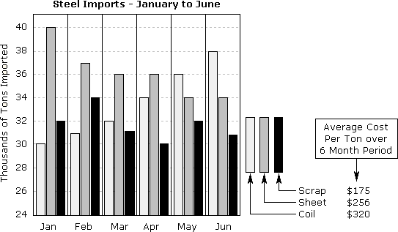
SATHYABAMA UNIVERSITY
UNIT- II
ENGLISH FOR SCIENCE AND TECHNOLOGY – SHS1101
d. The latest buzz word in the continuing debate about the environment is 'sustainable management' - that means using plants and animals for our own benefit, but ensuring that enough are left alive to guarantee the survival of the species.
Trans coding:
Interview two people and find out how much they spend on each activity and fill the gaps in the table below. Complete the gaps for myself first and approach the others . Write a short paragraph using comparatives.
Study the following chart to write a short paragraph of 200 words:
.
I X.
Write an application for Job with resume for the following advertisement in “The Hindu”, dated 21.12.2010
HUNDAI, requires Deputy Manager. Imagine that you are an M.E graduate with
experience in a private concern and apply for the post. or
Write a letter to the editor of „Deccan Chronicle‟ on the evils of electronic media and the steps that need to be taken individuals.
Notes- Reflections on Unit II:
-----------------------------------------------------------------------------------------------
-----------------------------------------------------------------------------------------------
New words & idioms learnt from the unit
----------------------------------------------------------------------------------------------------------------
------------------------------------------------------------------------------------New ideas
----------------------------------------------------------------------------------------------------------------
------------------------------------------------------------------------------------
New expressions
----------------------------------------------------------------------------------------------------------------
------------------------------------------------------------------------------------Areas to be improved
for ICA
-------------------------------------------------------------------------------------------------
-------------------------------------------------------------------------------------------------

